Slide 1

當 Bitcoin 遇上 Python
Ashe Liao
政大區塊鏈研究社- 12/04

Slide 2
https://bit.ly/2OZIhLv

Slide 3

我是誰

Slide 4
01
台灣微軟
公共業務事業群 Account Technology Strategist
技術中心 Data & AI team
臺灣大學
行為與資料科學研究中心 研究助理
資料科學與社會研究 課程助教
Coding & Co – working Club Python 講師

Slide 5
今天教什麼

Slide 6
02
從 Coingecko 下載最新的比特幣價格資料
畫出三種技術分析線圖，並判斷本日策略
自動發送email，推送本日價格和本日策略
Something about Microsoft

Slide 7
Workflow

Slide 8
Workflow
利用requests套件下載本日比特幣最新價格的csv檔
以Pandas套件進行資料前處理
以Matplotlib套件進行資料視覺化
計算 MA, EMA, MACD, Bollinger Bands
使用smtplib套件自動發送email通知本日價格及策略

Slide 9
技術分析指標

Slide 10
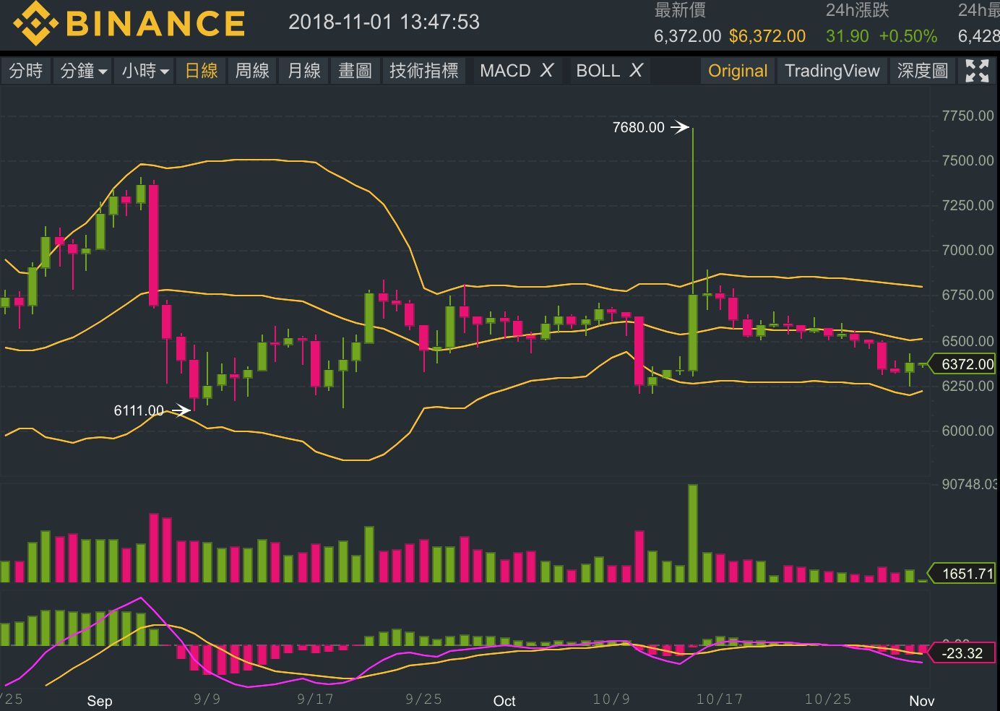

Slide 11
均線理論 Moving Average
N日均線:
過去N日的價格平均畫成的線，可以代表過去N日購入者的成本
超短期均線(5分, 30分)
短期均線(5日、10日)
中期均線(30日、60日)
長期均線(90日、200日)

Slide 12
均線理論 Moving Average
若三種均線均向下，代表空頭
反之，若三種均線均向上，則為多頭
均線可以做為型態確認、多空轉換的標的之一

Slide 13
均線理論 Moving Average
均線扣抵理論
可以判斷均線未來走向
若以五日均線來判斷
10/13 6285
10/14 6314
10/15 6328
10/16 6659
10/17 6635
若10/18日的價格高於5日前的6285，均線將會上揚

Slide 14
均線理論 Moving Average
盲點

Slide 15
均線理論 Moving Average
將過去N日的價格做算術平均，
代表將過去N日的價格影響視為相同。
然而，過去N日對今日價格和未來價格
的影響應該是每日遞增。

Slide 16
指數移動平均 Exponential Moving Average
指數移動平均(EMA)
是以指數式遞減加權的移動平均。
各數值的加權影響力隨時間而指數式遞減，
越近期的數據加權影響力越重，
但較舊的數據也給予一定的加權值。

Slide 17
MACD
用於研判價格變化的強度、方向、能量以及趨勢
首先計算12日和26日的指數移動平均 ，
令DIF為12日EWA – 26日EWA
再令DEM為DIF的9日EMA

Slide 18
MACD
若DIF自下而上突破DEM，為買進訊號
若DIF由上而下穿透DEM，為賣出訊號

Slide 19
Bollinger Bands
布林通道由三條線組成
當前價格
20天的移動平均線 + 兩倍標準差
3. 20天的移動平均線 - 兩倍標準差

Slide 20
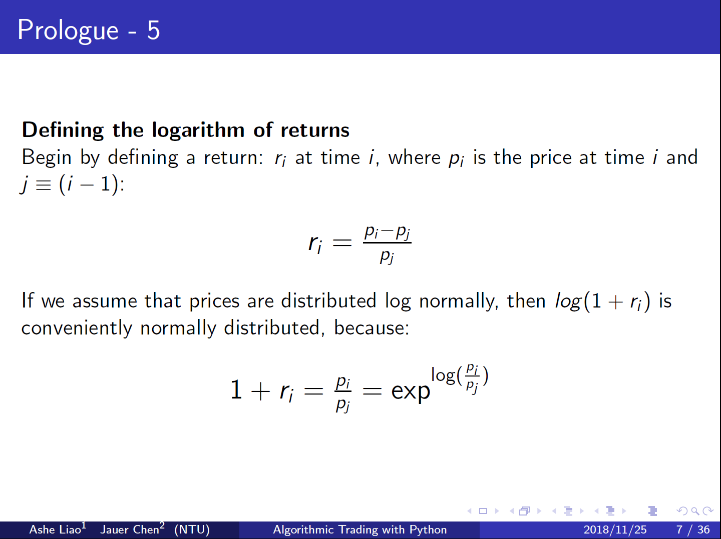

Slide 21
Bollinger Bands
簡單來說，如果我們相信價格是log的常態分配
而布林通道包含了20日均線的4個標準差，換句話說，布林通道涵蓋了近96%的價格機率。

Slide 22
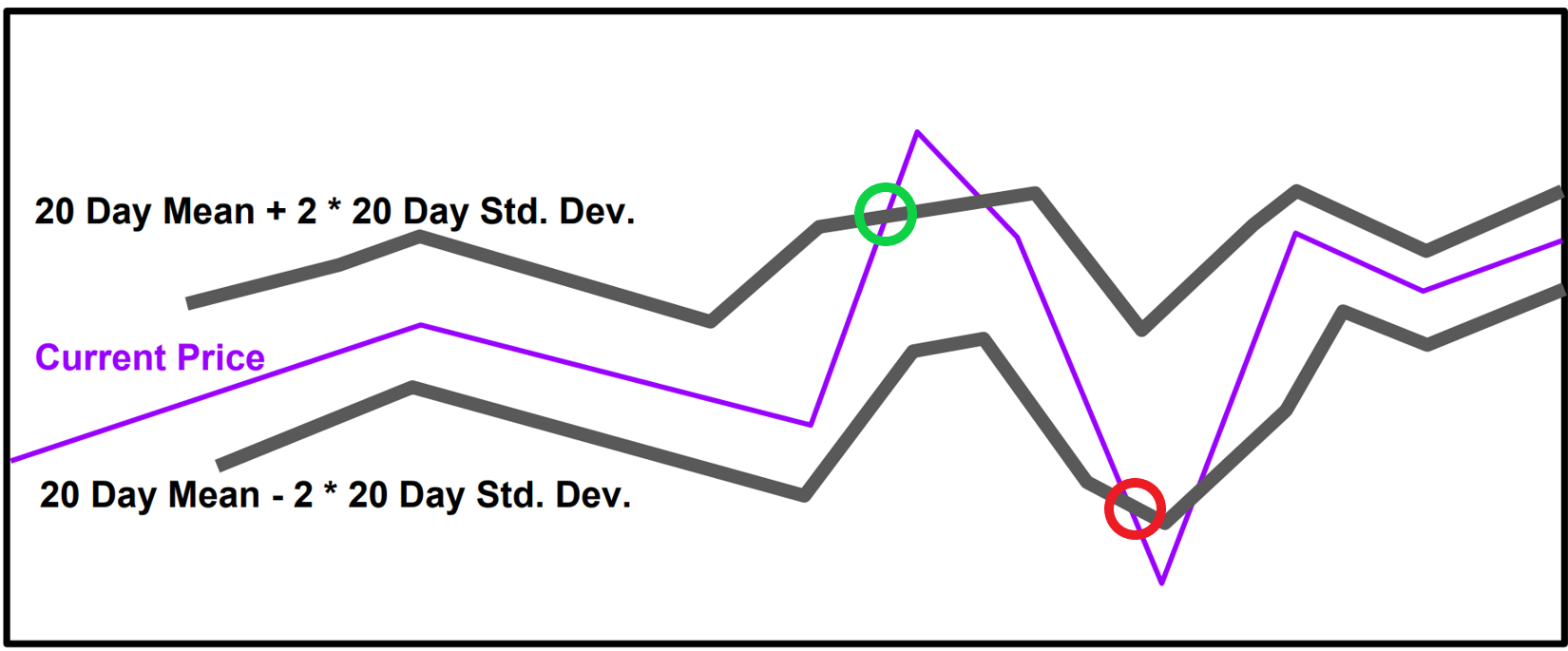
壓力線
支撐線

Slide 23
Workflow
利用 requests 套件下載本日比特幣最新價格的csv檔
以 Pandas 套件進行資料前處理
以 Matplotlib 套件進行資料視覺化
計算 MA, EMA, MACD, Bollinger Bands
使用 smtplib 套件自動發送email通知本日價格及策略

Slide 24
虛擬貨幣市場的風險性較傳統的股、債市更高。
加上資金過度集中，易造成Pump & Dump
這是無法透過以上所學的方式來判斷走向的。

Slide 25
One more thing…

Slide 26


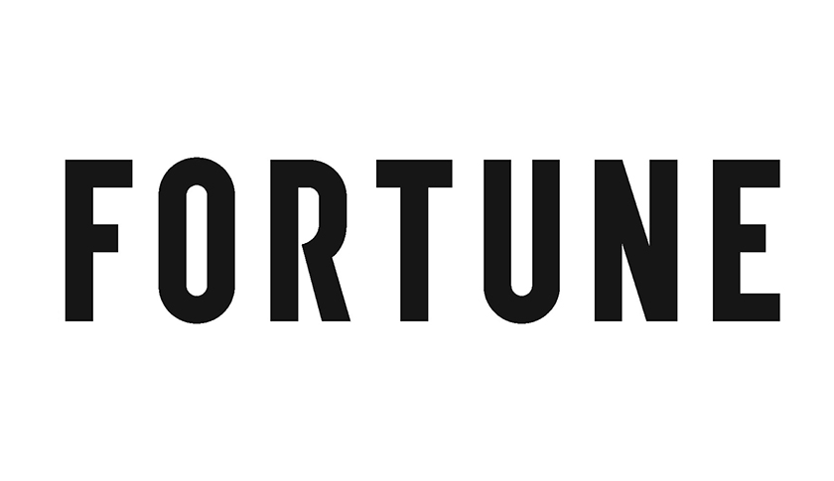

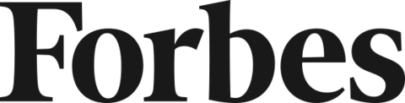

Blockchain is not just about currencies
Blockchain will be the killer app for supply chain management in 2018
“…a sweeping vista of opportunity to reimagine how the financial system can and should work in the Internet era, and a catalyst to reshape that system in ways that are more powerful for individuals and businesses alike”
- Marc Andreessen, A16z
Are You Eating Sustainable Fish? Blockchain May Provide the Answer
How Blockchain Technology Could Work in the Insurance Industry
How Blockchain Can Create Owned And Trusted Health Care Records

Slide 27
Blockchain shows tremendous potential across industries
Manufacturing
Retail
Insurance
Banking and Capital Markets
Government
Health
Asset tracking
Real time auction for supplier contracts
Supply chain transparency
Loyalty tracking
Product provenance
Logistics management
Claims Management
MBS/Property Payments
Fraud detection
Automated underwriting
Bond Issuance
Trade Finance
Loan Syndication
Post Trade Settlement
Cross Border Payments
Derivatives Trading
KYC/AML
Licensing and ID
Benefits distribution
Aid tracking
Military security
Personalized medicine
Records sharing
Compliance

Slide 28

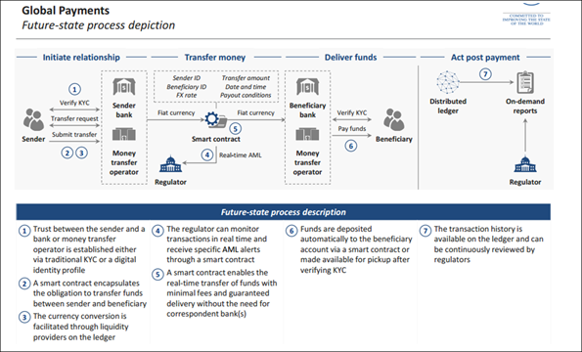
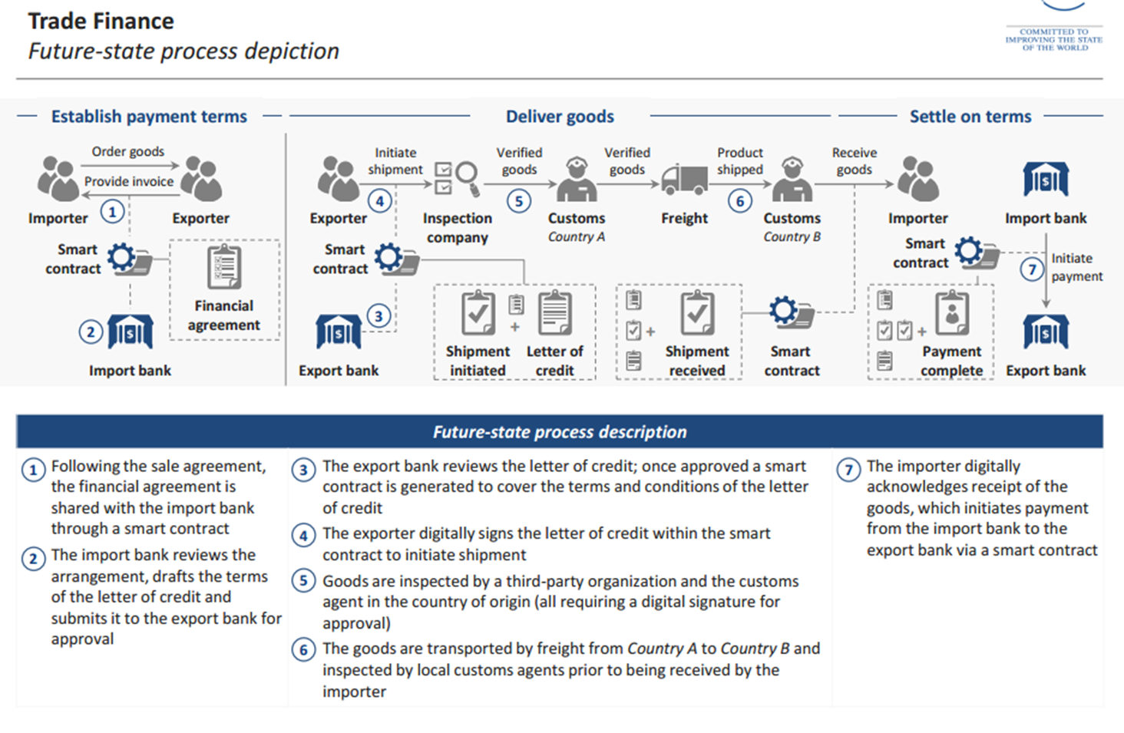
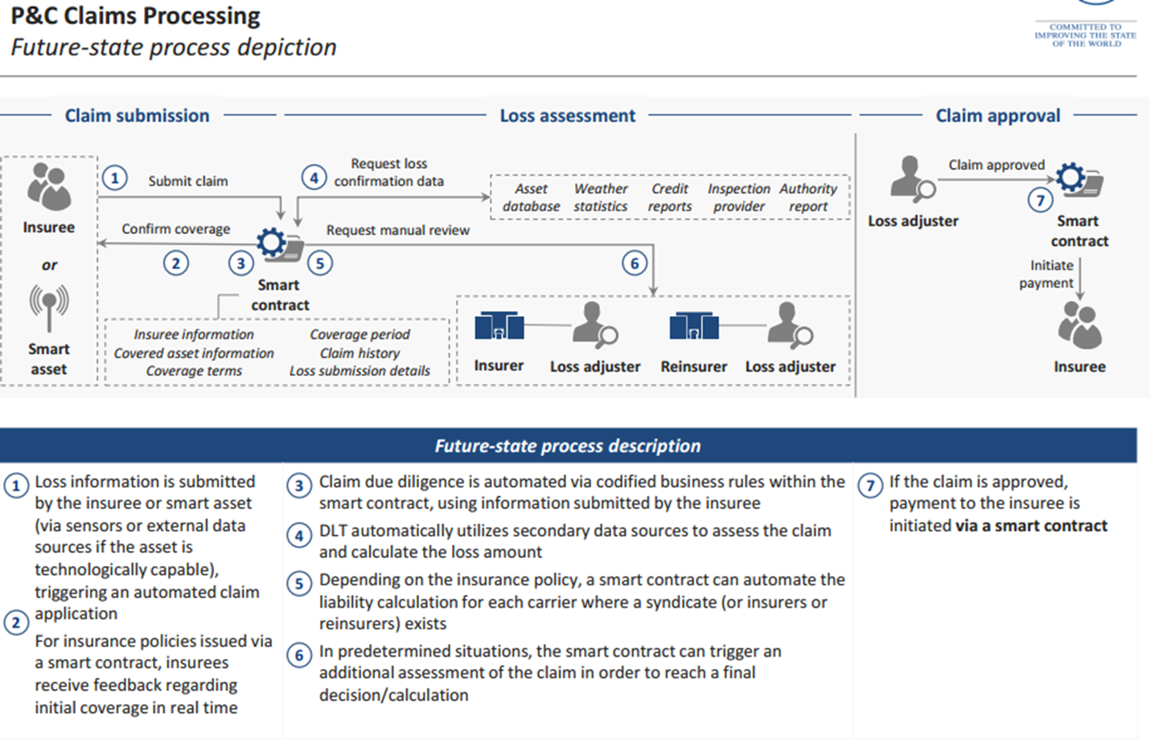
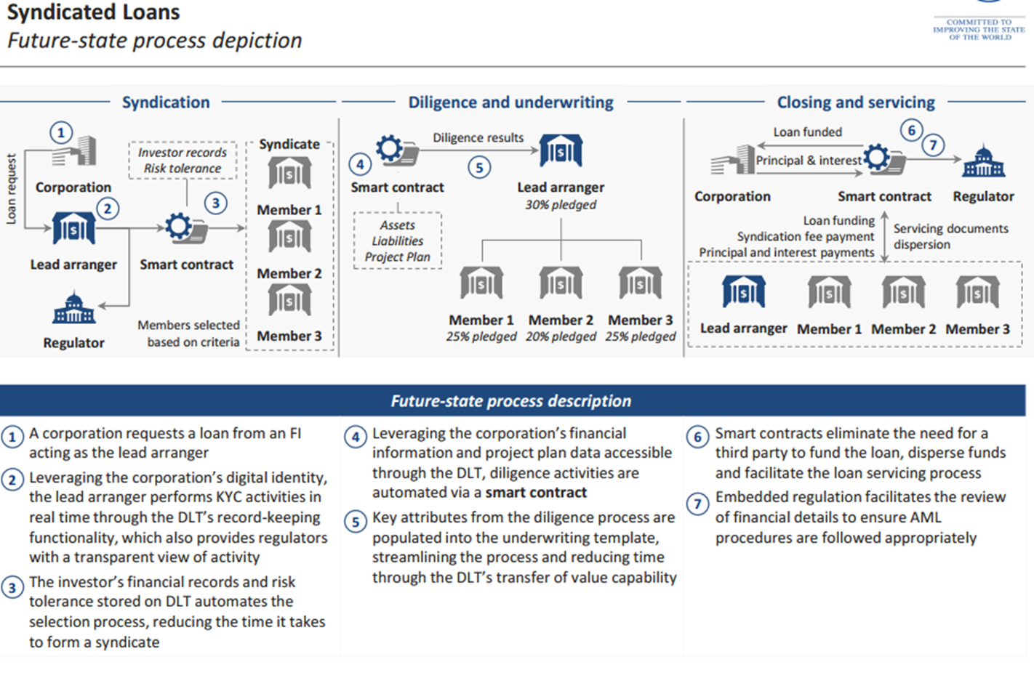
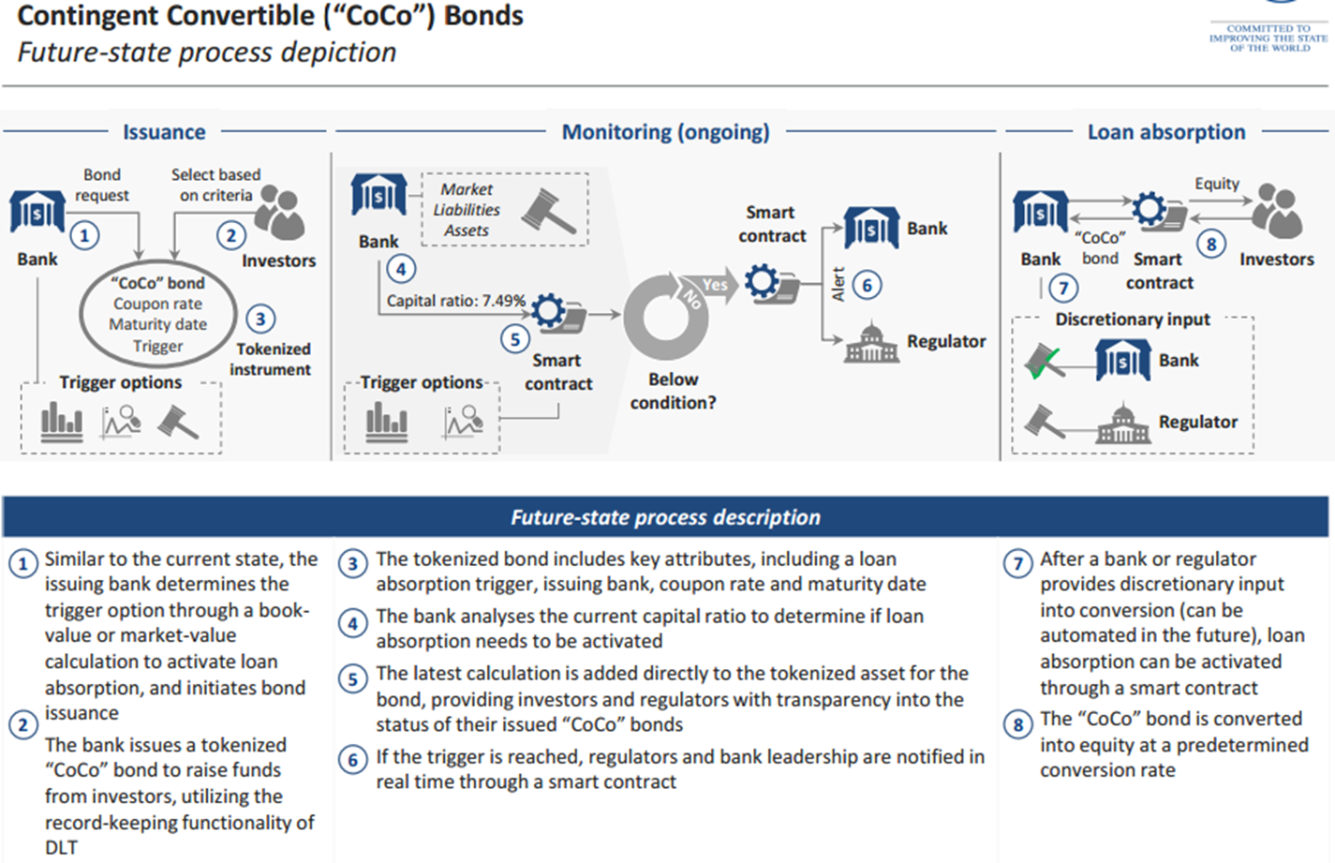
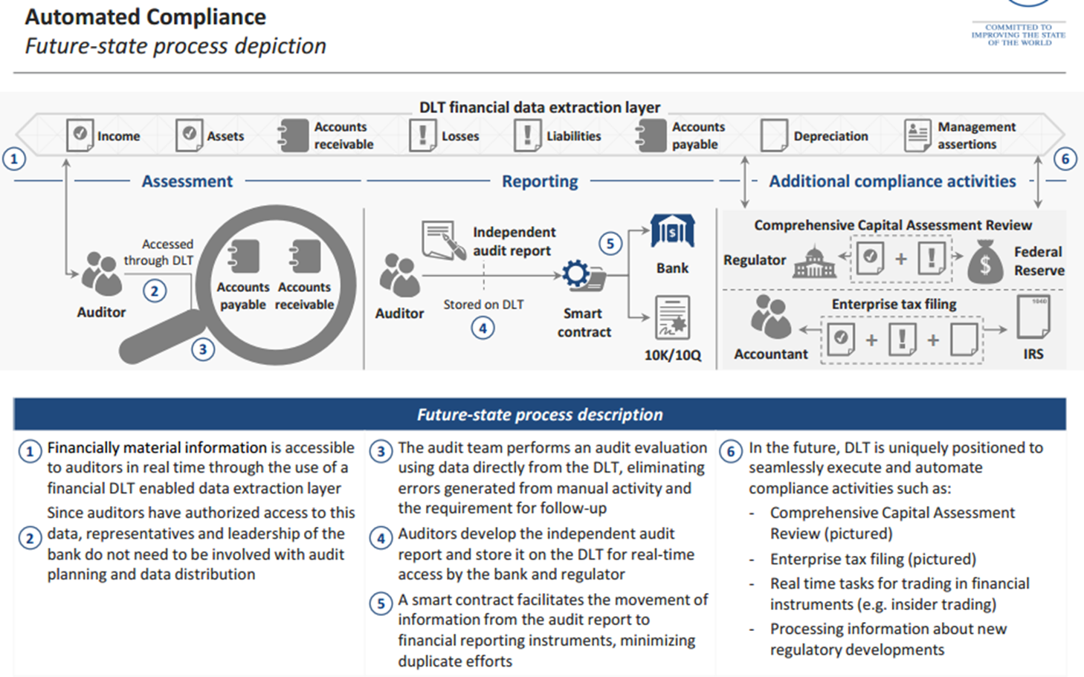
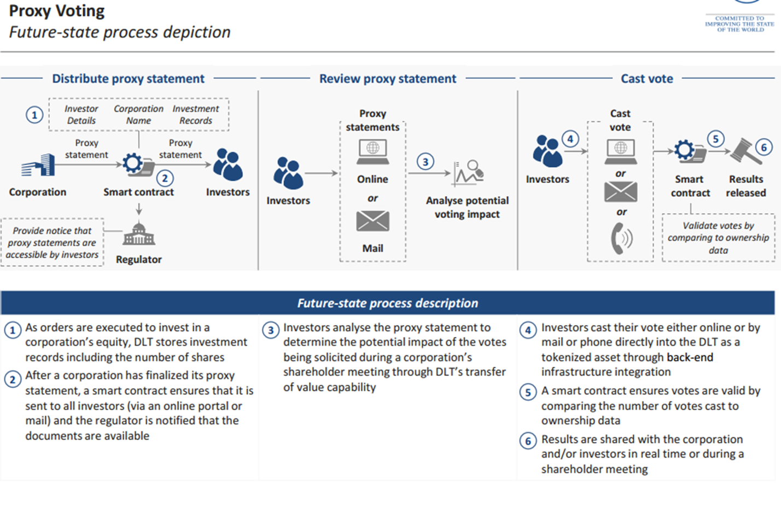
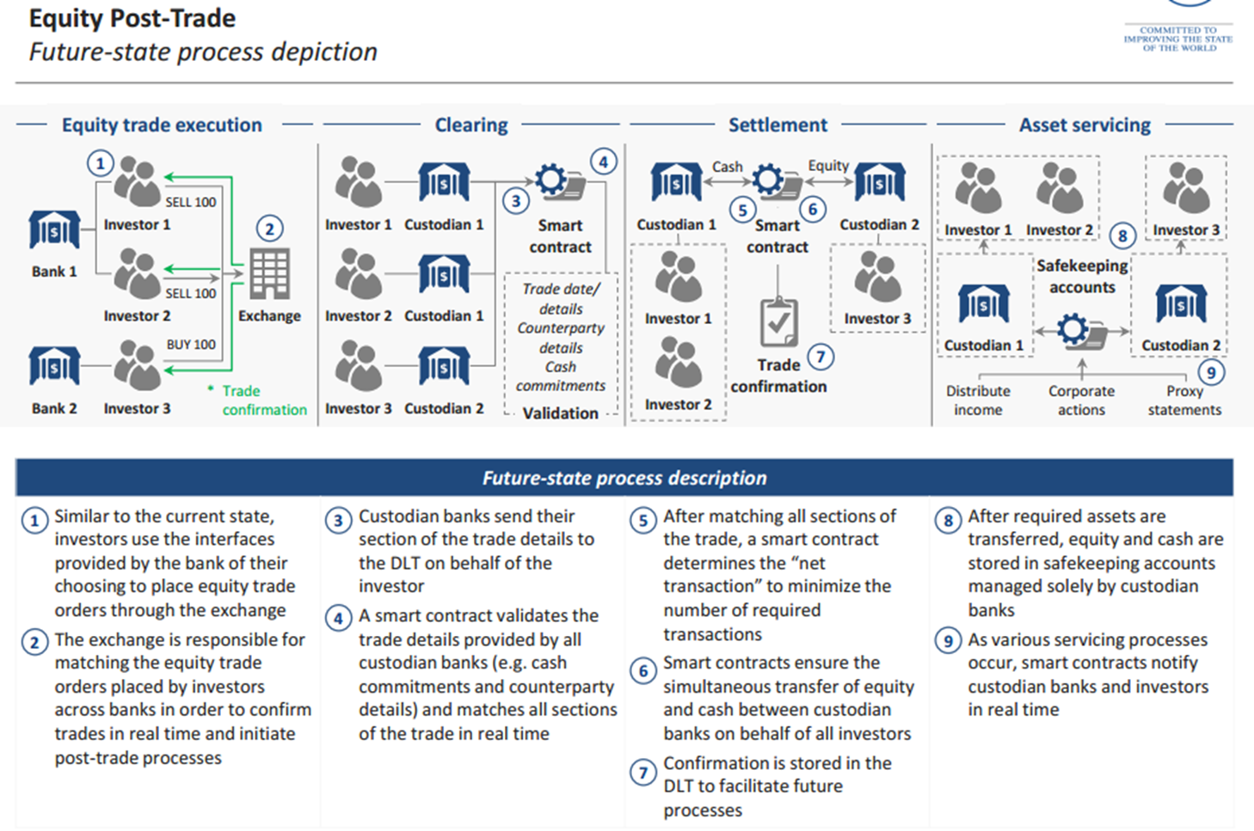
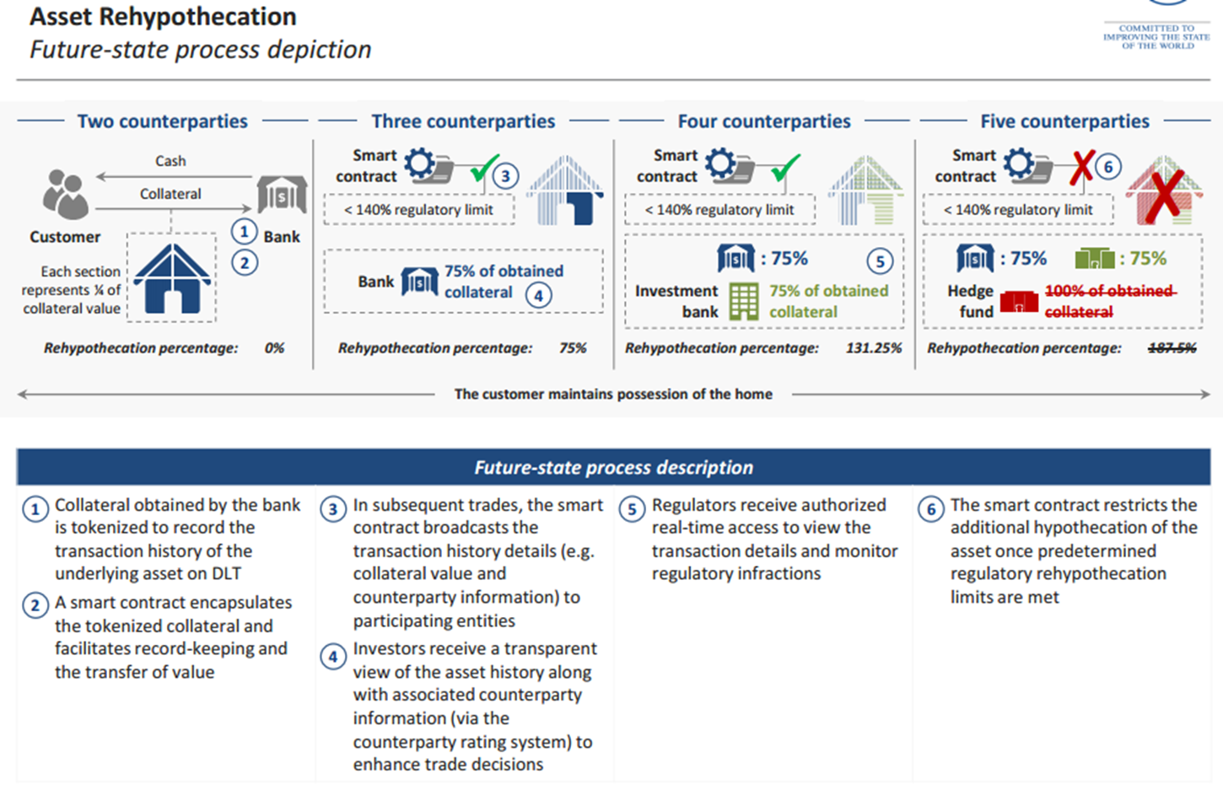
Global Payments
Trade Finance
P&C Claims Processing 索賠處理
Syndicated Loans (聯合貸款)
Convertible (“CoCo”) Bonds 應急可轉債
Automated Compliance
Proxy Voting (代理投票)
Asset Rehypothecation (資產再抵押)
Equity Post-Trade (股權交易)

Slide 29

Why isn’t everyone using blockchain right now?
Blockchain wasn’t built for enterprise
Ledgers
Ledgers designed for public network lack the performance, confidentiality, and governance capabilities needed for commercial use
Smart Contracts
Smart contracts were not designed to leverage existing enterprise tools and skill sets
Integration
There are a number of challenges to integrate a blockchain with existing IT architecture

Slide 30
What is Azure building ?

Slide 31
Because building an end-to-end blockchain app is a huge undertaking
Link identities to federated systems
Integrate with existing business apps
Configure consortium network
Ingest messages and events
Manually deploy
ledger
Synchronize data with off-chain DB
Write business logic
Extend capabilities
Orchestrate signing, hashing and routing
Customize integrations
Store smart contract reference data
API
management
Manage keys
Build web client

Slide 32
So we’ve taken steps to create a platform that would tackle those challenges
1
2
3
Populated preconfigured networks
Integrated relevant cloud services
Built a simple interface

Slide 33
Microsoft’s Blockchain Solutions
ARM Deployment Templates
Stand-up a Blockchain network on the network of your choice
Azure Blockchain Workbench
Blockchain network and scaffolding to enable quick deployment and distributed app development
Azure Blockchain Service
Fully-managed distributed ledger service enabling quick deployment, management and Azure integration
Confidential Consortium Framework – CCF (formerly Coco Framework)
Secure enclave technology that dramatically increases speed of consensus while maintaining trust
Enterprise Smart Contracts
Develop smart contracts in the language of your choice, securely integrated with the blockchain

Slide 34

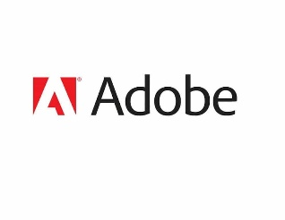
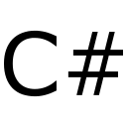
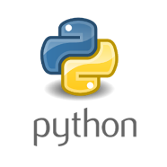
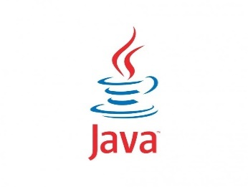

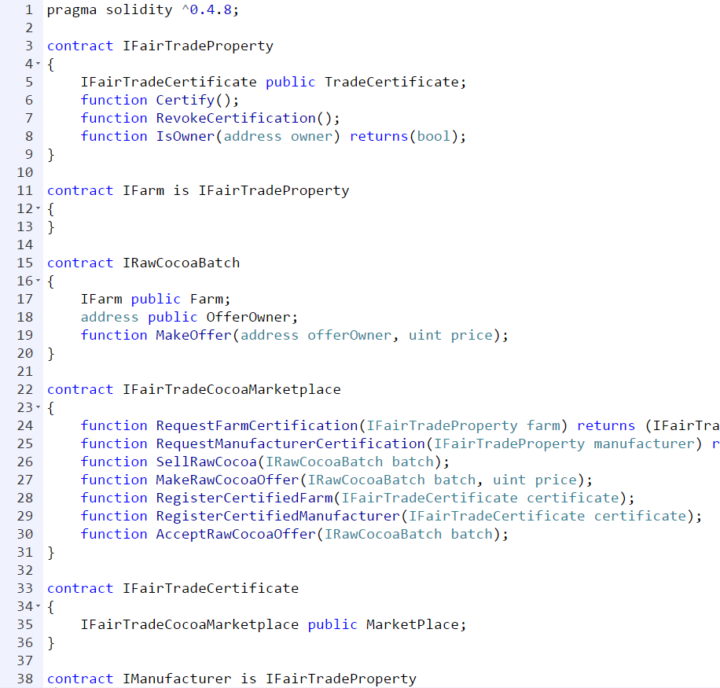
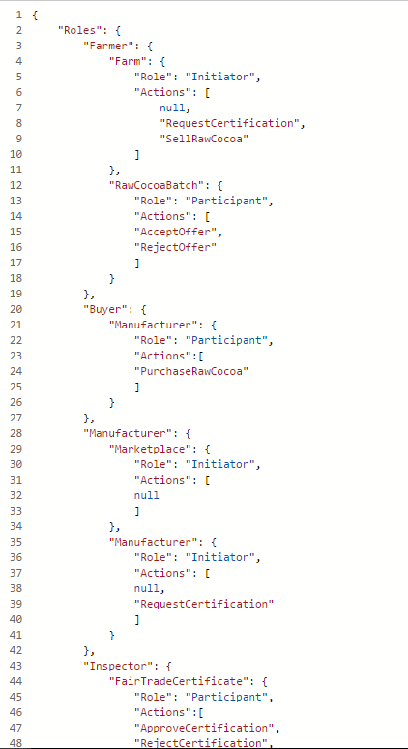
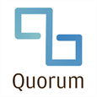
Microsoft’s Blockchain Solutions
Client Apps
1st and 3rd Party Apps and Services
Devices
Enterprise Smart Contracts
In Development
Azure Blockchain Workbench
In Public Preview
Workflow execution
Identity & key management
Integration APIs & events
Workflow/user admin
Workflow
Config
→
Workbench
Azure Blockchain Service
In Public Preview
Fully-managed service
Ledger-agnostic
Hyperledger Fabric
Ethereum
Quorum
Corda
Trusted Execution Environment (Intel SGX, Windows VSM)
Confidential Consortium Framework
GitHub Open Source

Slide 35
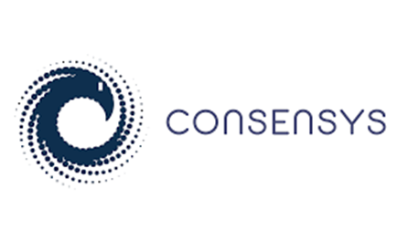



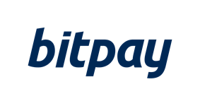
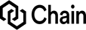
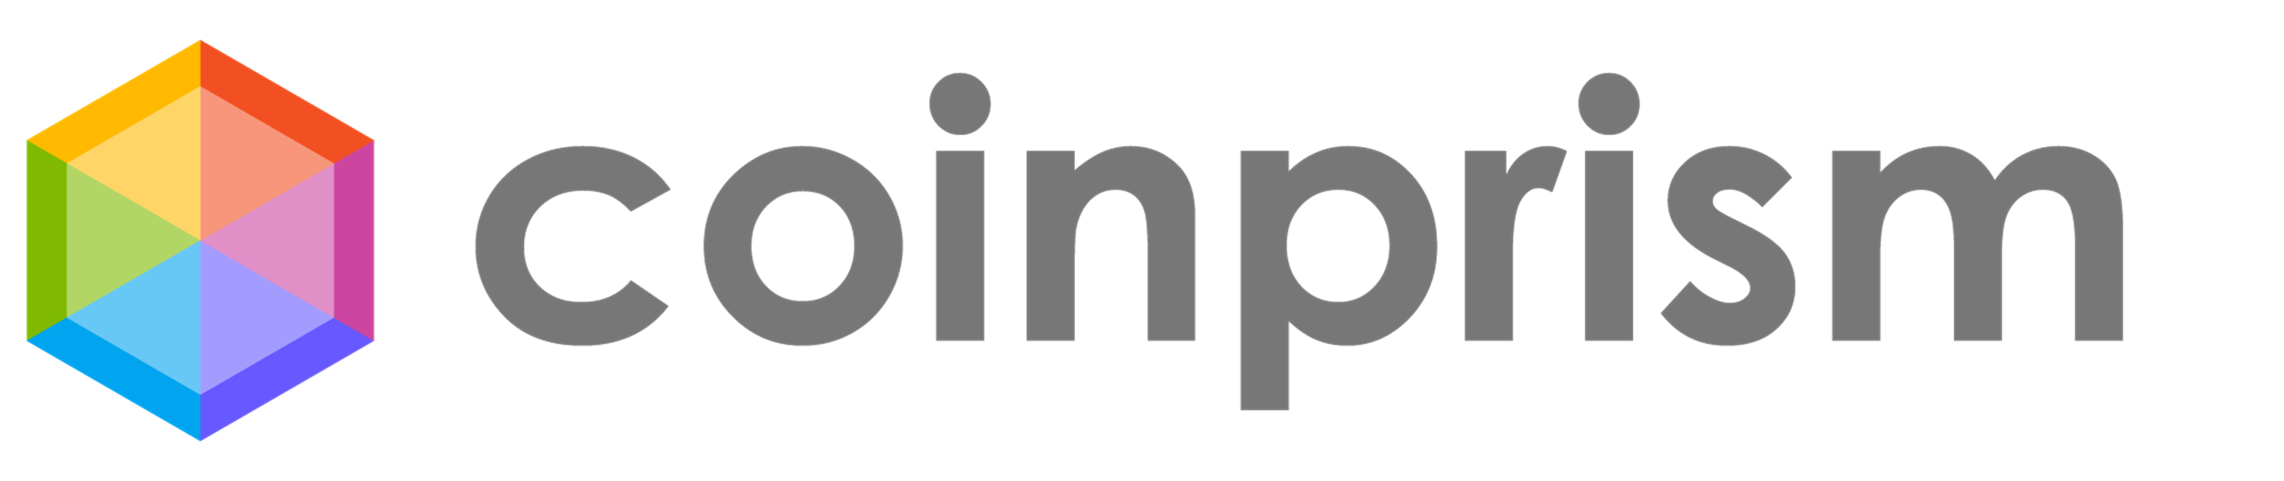
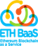
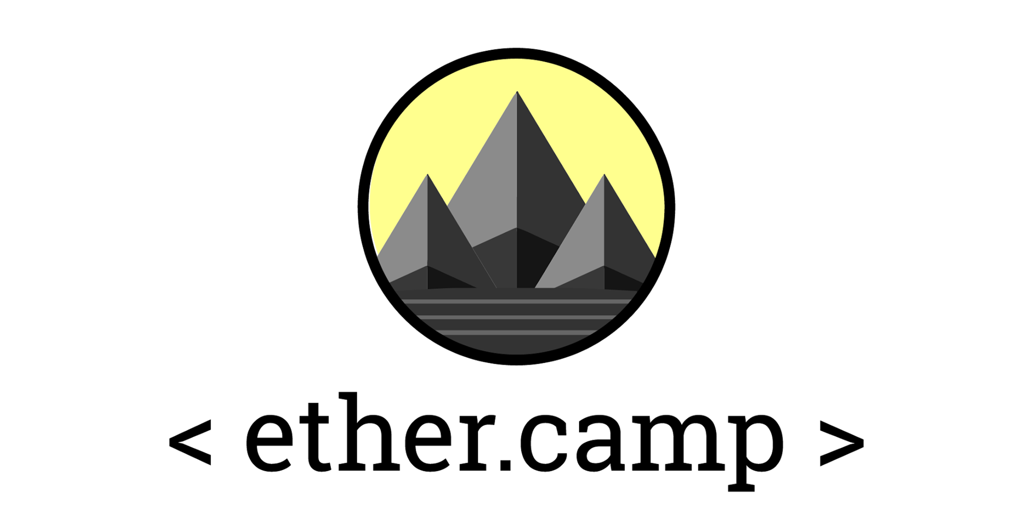




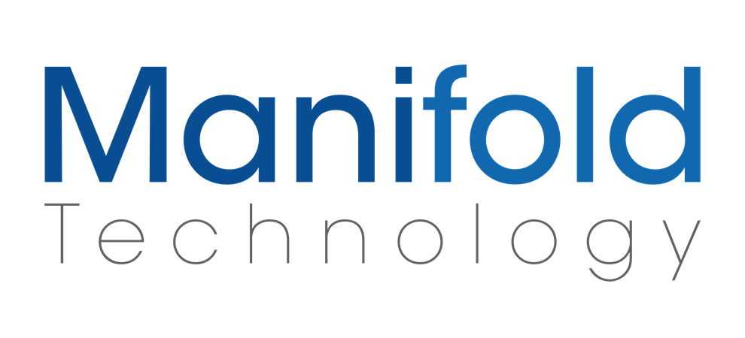



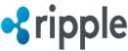
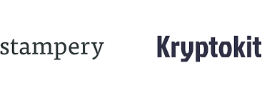

Why Microsoft for Blockchain?
Open Blockchain Ecosystem
Our platform will integrate with our customer investments (incl. Azure)
Regulatory and Compliance Ready (incl. Financial Services)
Azure

Slide 36

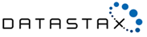

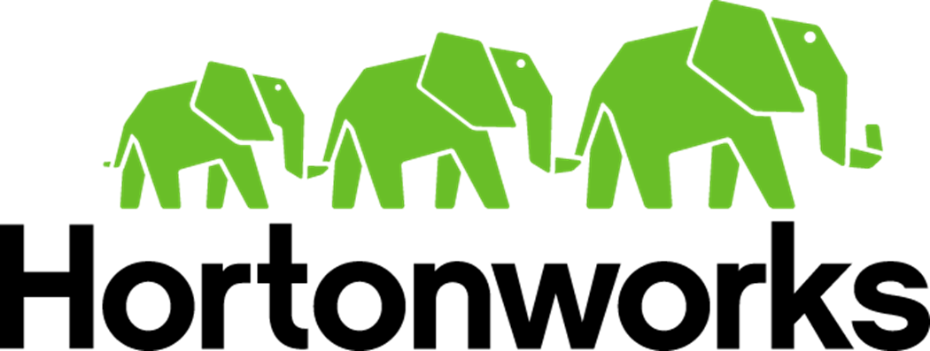
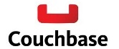
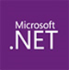





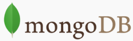



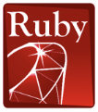


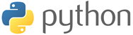





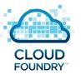




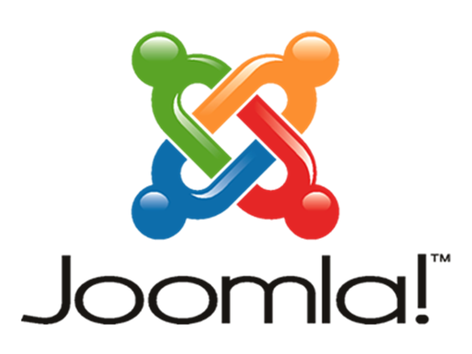
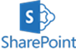




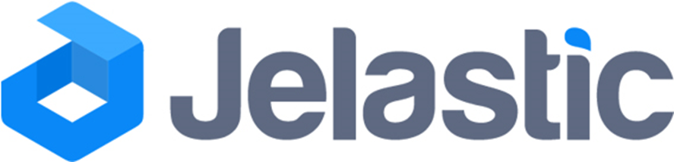




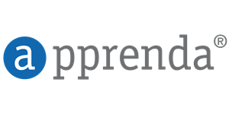
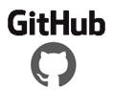


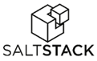


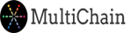
Microsoft Azure | An Open Cloud
Infrastructure
Databases
App Frameworks
Hyper Scale
Enterprise Grade
Hybrid
We’ve delivered an open, broad, and flexible cloud across the stack
SQL Server
Blockchain Offerings on Azure
+Hundreds of community supported images on VM Depot
Applications
Management
Clients
Web App Gallery
Dozens of .NET & PHP CMS and Web apps

Slide 37
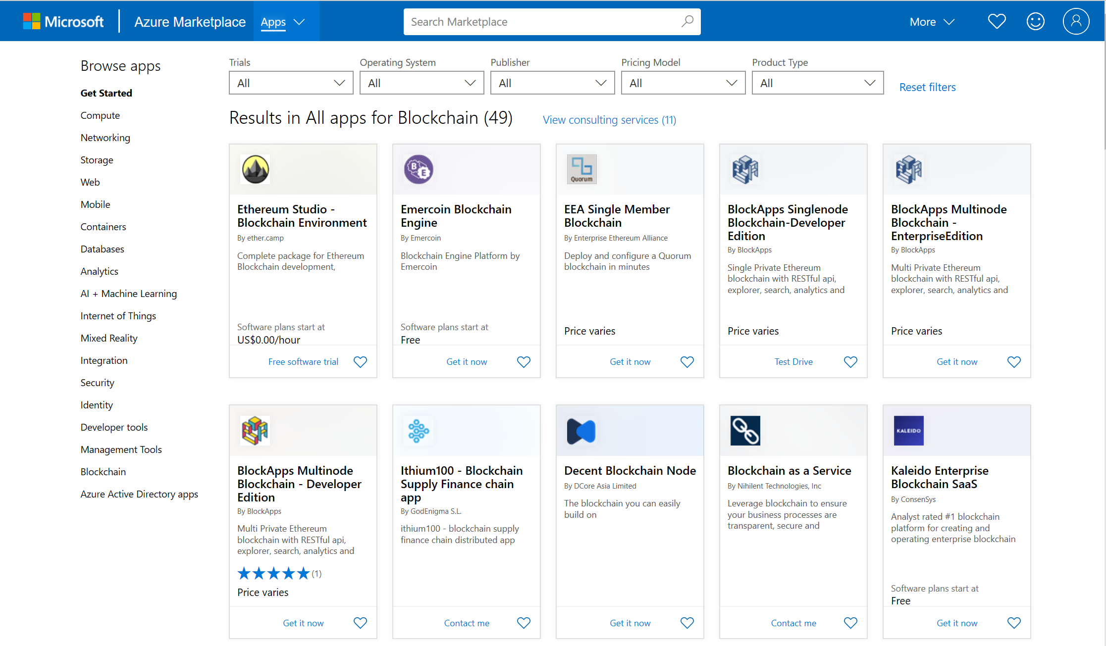
Drive partner innovation and scale by providing blockchain tools and pre-configured solutions through our marketplaces
Promote engagement and innovation by onboarding ISVs into Azure Marketplace and AppSource
Enable customers and partners to discover, publish and transact blockchain components and services from smart contracts to complete SaaS offerings

Slide 38
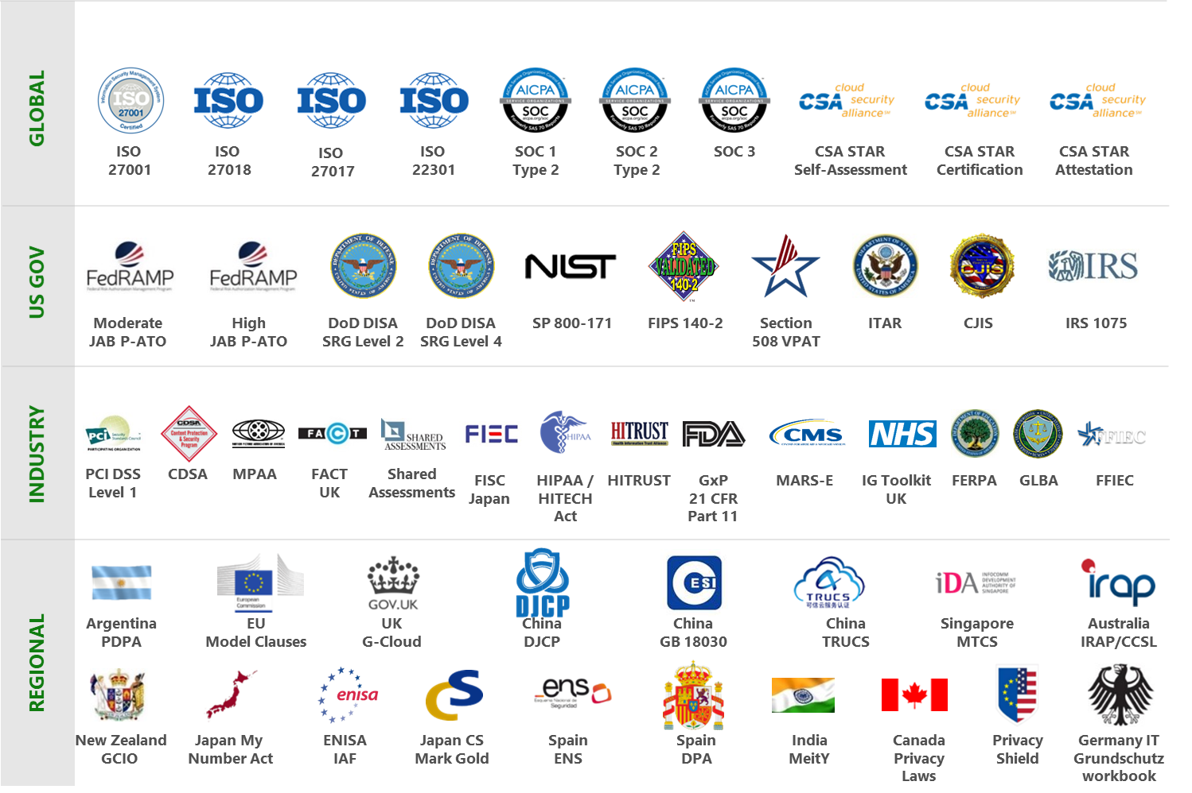
The most trusted and compliant cloud

Slide 39
So you can focus your time on adding value for your business
Integrate with identity and key vault services
Integrate with existing business apps
Configure consensus algorithms
Link identities with federated systems
Integrate with existing business apps
Configure consortium network
Manually deploy ledger on a network
Manually deploy
ledger
Manage post-processing storage
Ingest messages and events
Synchronize data with off-chain DB
Retrieve reference data
Extend capabilities
Write business logic
Extend capabilities
Write business logic
Manage pre-processing and storage
Orchestrate signing, hashing and routing
Store smart contract reference data
Deploy gateway API
Customize integrations
Perform post-processing compute
Customize integrations
Build web client
API Management
Create oracles
Build web client
Manage keys

Slide 40
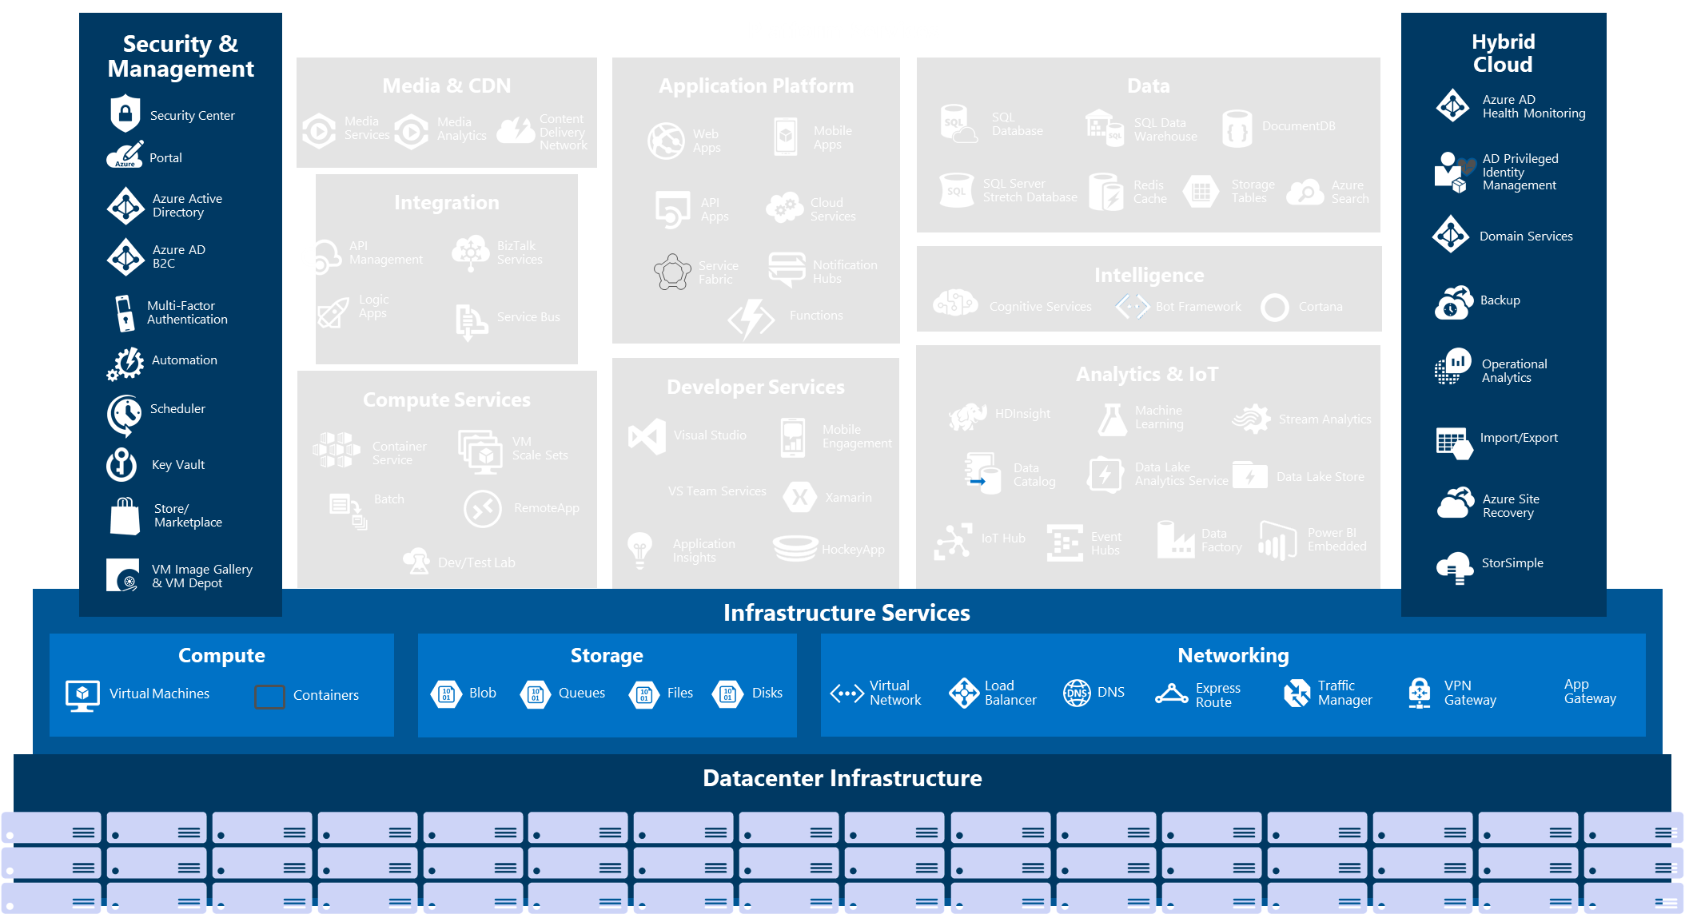
Azure 相關服務

Slide 41
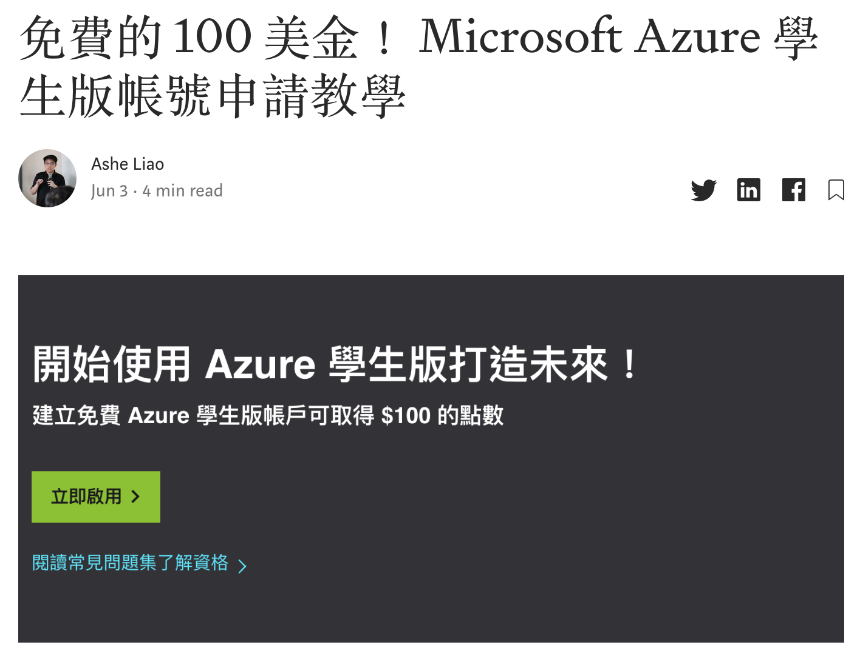
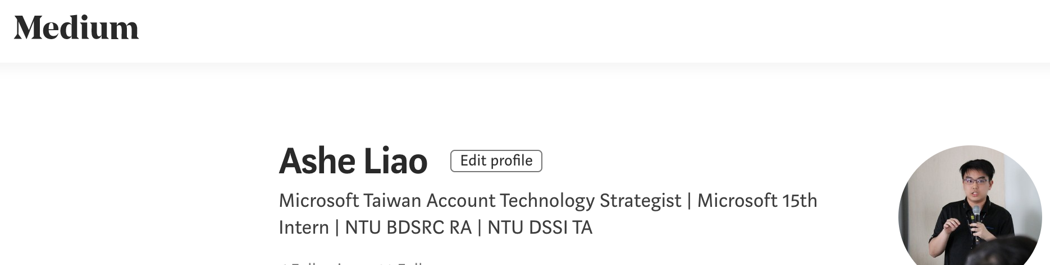

Slide 42


THANK YOU
Ashe Liao
Ashe Liao

